Slide 1
Programming
Requirements
Code

Slide 2
Programming
Requirements
Logic

Slide 3
Requirements
Mind the Gap!
Logic

Slide 4
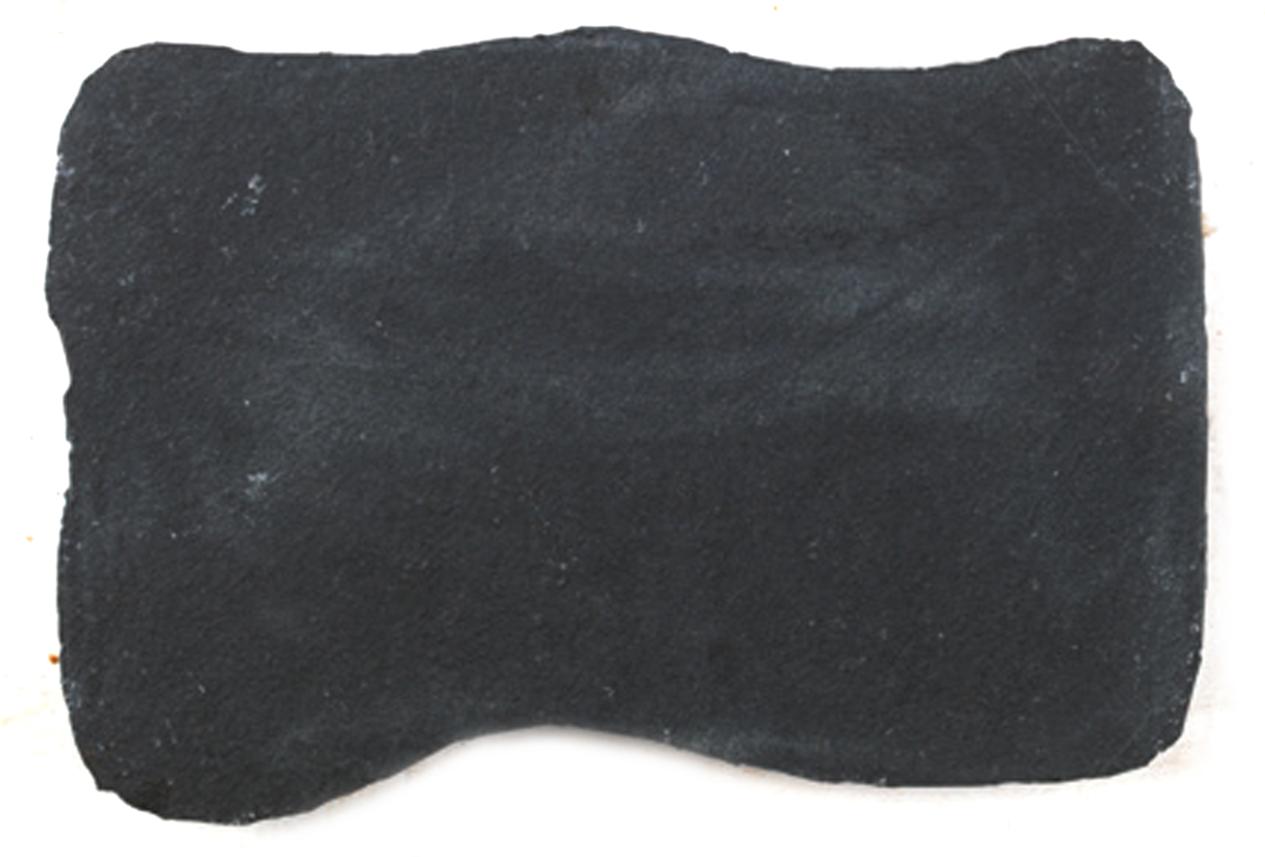
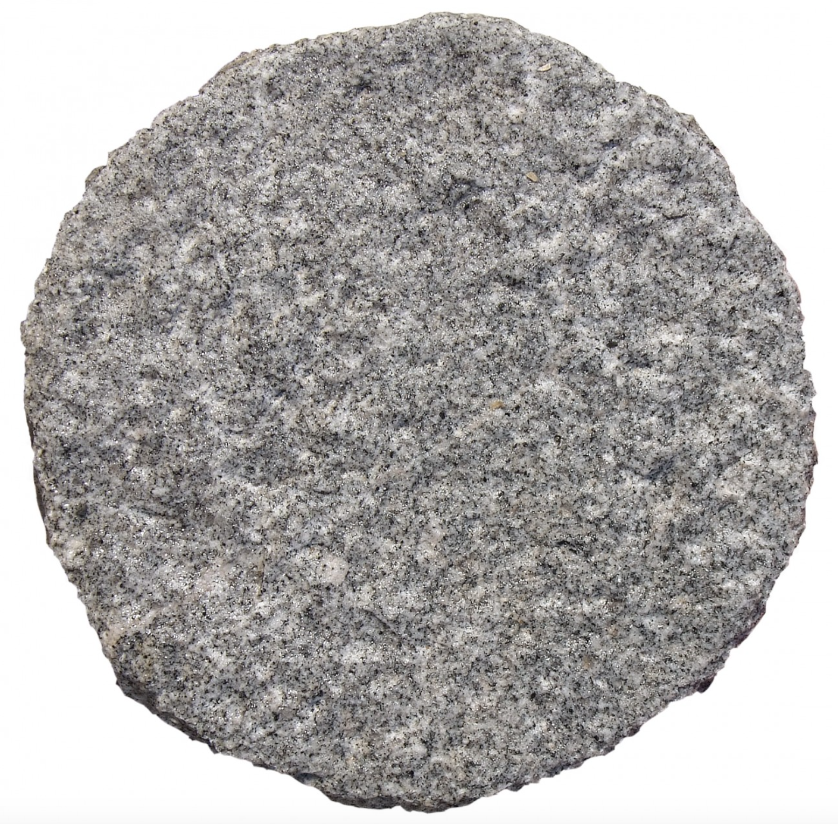

Requirements
Problemanalyse
Lösungs-
entwurf
Implementation
Logic

Slide 5
Anforderungs-analyse
Lösungs-entwurf
Implemen-tation
?
?

